Slide 1
Building modern Office add-ins with HTML5 and JavaScript
Richard diZerega
Microsoft – Developer Experience
www.richdizz.com
@richdizz

Slide 2
Opportunity
850 million meetings are created a month
Over 4 trillion emails sent with O365
100+ million downloads of mobile apps
2–3 hours/day spent in Office apps
1.2 billion+ users
470+ PB of storage

Slide 3
Developer vision
USERS
DATA
HTML
Notes:
Our Office 365 developer vision focuses on the Users’ experience and their data. As a developer you can bring your applications into their user experience. With over 1.2+ billion users of Office Worldwide, this is a huge opportunity to provide a window into your applications. As well as being able to connect into their data and add intelligence to your applications. There are currently 850 million events created a month and a total of 470Pb+ of data stored in the service that can add value to for our Users’.

Slide 4
Historical Challenges with Office Add-ins
Proposals would be much more enjoyable as a game!
But where to fine one???
Will Pac-Man Proposals work on the latest version of Windows and Office?
We have 100K employees that build proposals…how will we distribute???
Proprietary Development
Discoverability
Decentralize Distribution
Updates/Upgrades
Devices/Mobility
Internet Ready
Can I run Pac-Man Proposals on my iPad?
Behold…I bring the world…
Pac-Man Proposals for Word!!!
Ewww…COM, VBA, and VSTO Development…REALLY?!?!
My Chromebook has an awesome browser!
v
v
Notes:
Traditional Office add-ins have been built using old or proprietary development technologies like VBA, COM, and VTSO
(ok…our developer got past the development tools and built a great Office add-in…but how are people going to find it?)
Great Office add-ins were hard to find as there was no centralized marketplace to find them
(ok…lets say people find the great Office add-in…what about distribution)
Traditional Office add-ins were installed along side Office and execute with Office, meaning you have to distribute it
What if you want to upgrade to a new version of Office…does the add-in support that? How many of you have heard of someone stuck in an old version of Office because of an add-in?
We are living in a mobile world these days and users want to be productive on the go…traditional add-ins certainly won’t install on mobile devices
We are also living in an age were many users just want to use a browser…traditional add-ins can’t run in Office Online

Slide 5
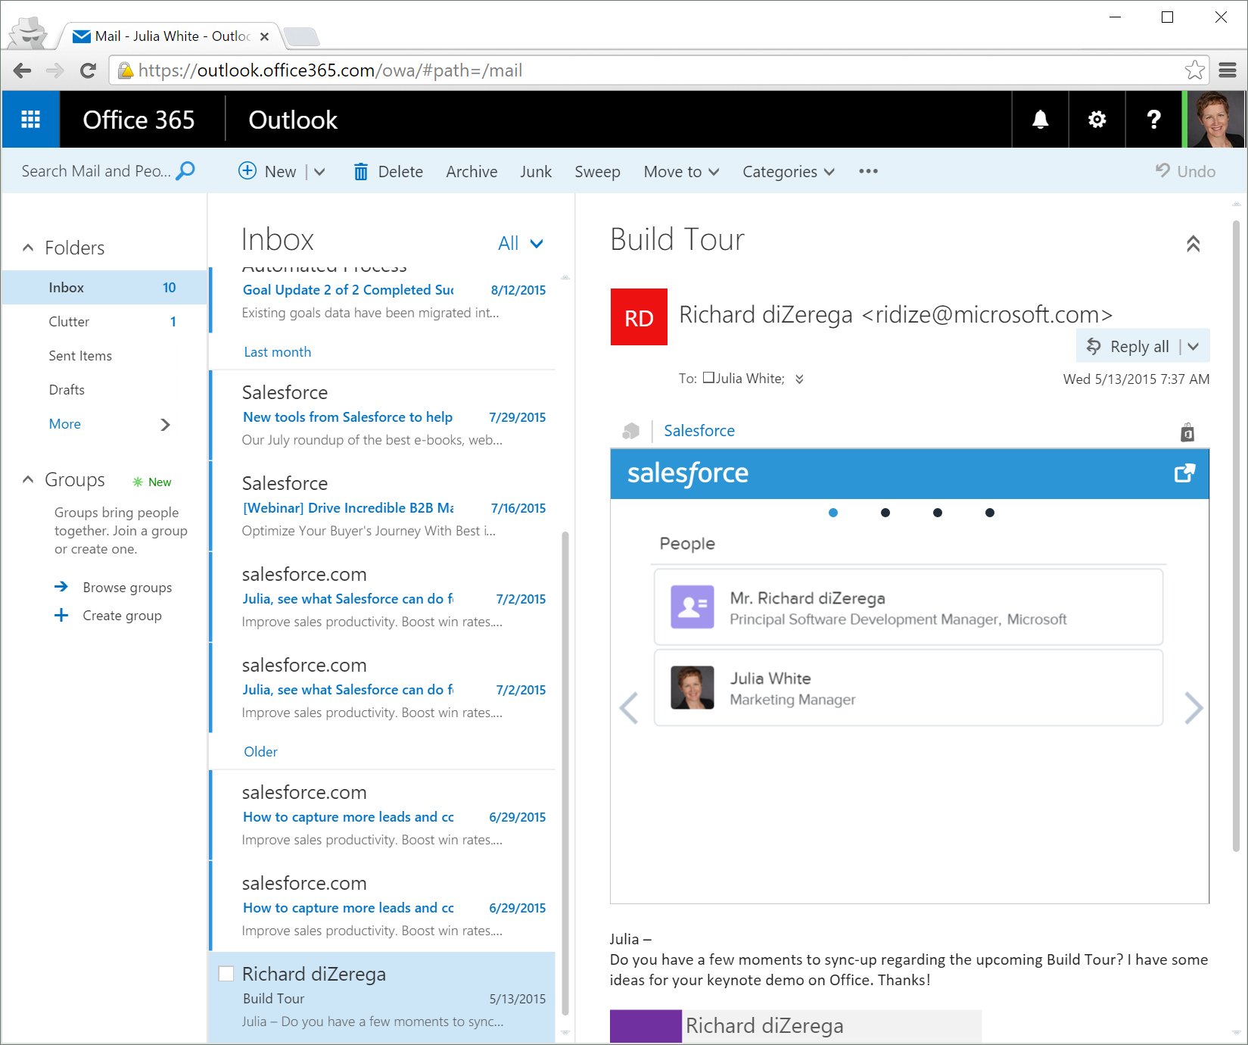
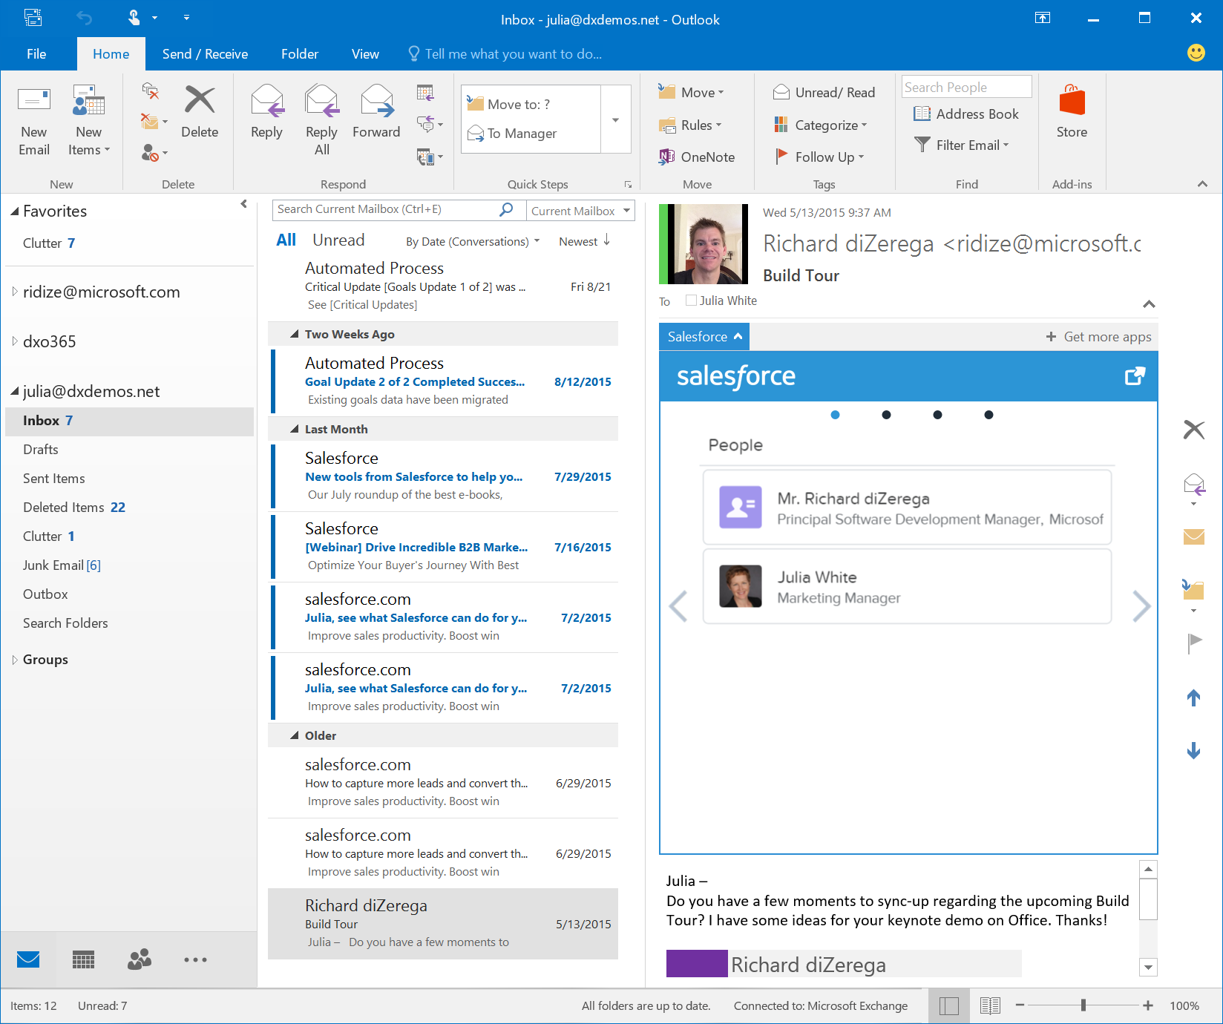
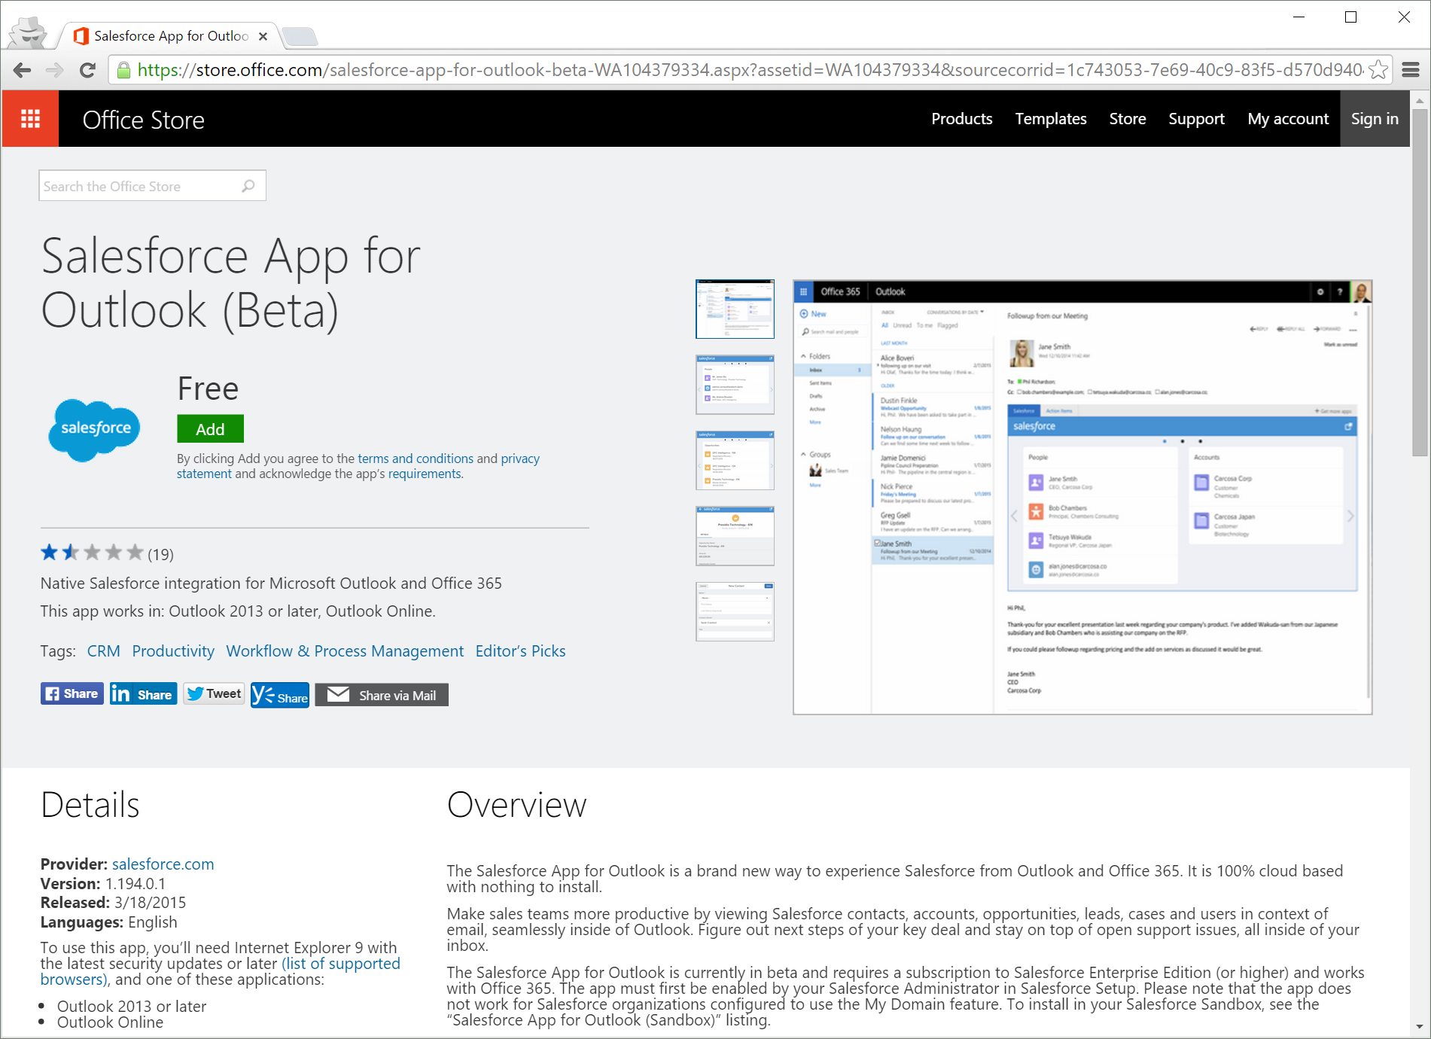
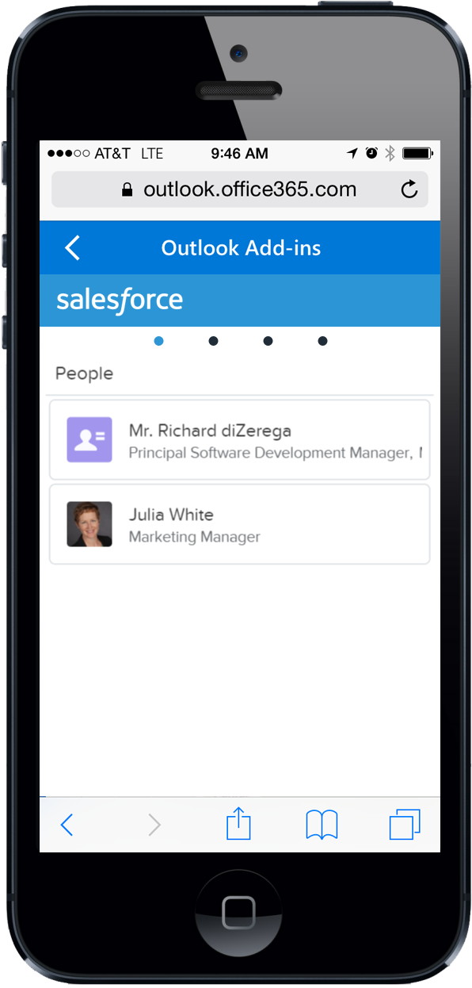
Enter the Modern Web Add-in
<?xml version="1.0" encoding="UTF-8"?>
<OfficeApp xsi:type="MailApp">
<Version>1.0.0.0</Version>
<ProviderName>Salesforce.com</ProviderName>
<DefaultLocale>en-US</DefaultLocale>
<DisplayName DefaultValue=“Salesforce" />
<Capabilities>
<Capability Name="Mailbox" />
</Capabilities>
<DesktopSettings>
<SourceLocation DefaultValue=“https://salesforce.com/office" />
<RequestedHeight>300</RequestedHeight>
</DesktopSettings>
<Permissions>ReadItem</Permissions>
<Rule xsi:type="RuleCollection" Mode="Or">
<Rule xsi:type="ItemIs" ItemType="Message"/>
<Rule xsi:type="ItemIs" ItemType="Appointment"/>
</Rule>
</OfficeApp>
Built with web standards
Office.js provides interop
Hosted centrally
Almost zero client footprint
Runs where Office runs
Discoverable marketplace
Office.js
Browser Control
or iFrame
With HTML5,
JavaScript, CSS
Web Server

Slide 6
Office Add-ins A new way to build extensions for Office
Contextual Mail Add-in
Add-in launched contextually from a mail message or appointment
Outlook and Outlook Web Access (OWA)
Task Pane Add-in
Add-in that runs beside a document/mail with read/write access
Word, Excel, PowerPoint, Project, Outlook
Content Add-in
Add-in that runs within a document content with read/write access
Excel, PowerPoint, Access
Add-in Command
Command in the Office UI to launch add-in or perform UI-less operation
Outlook, Outlook Web Access (OWA)

Slide 7
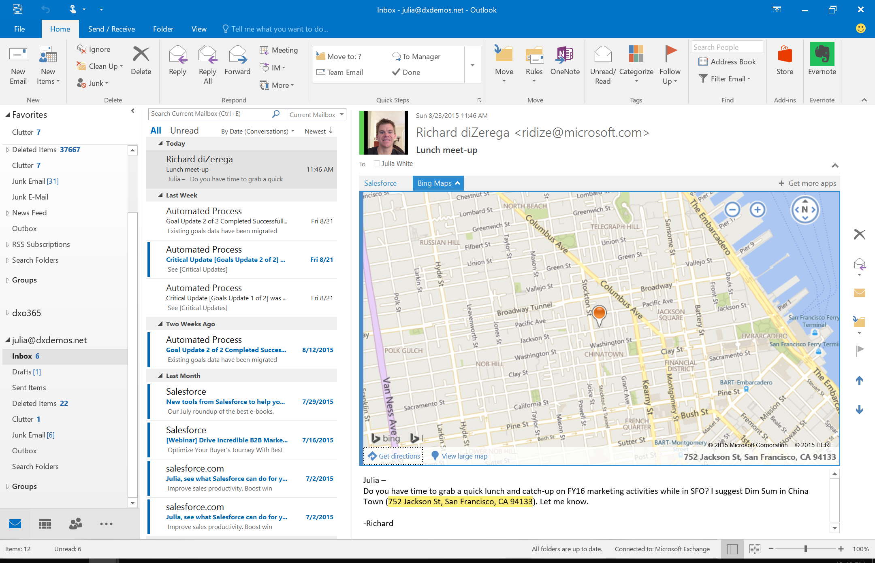
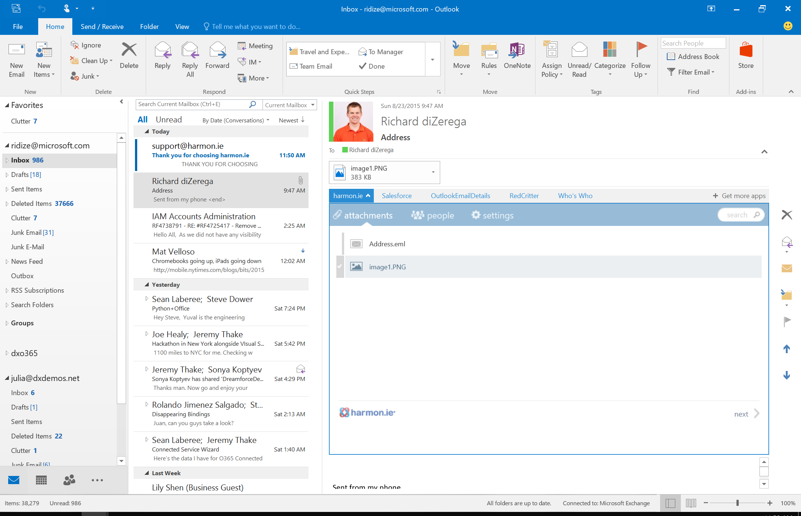
Contextual Mail Add-in

Slide 8
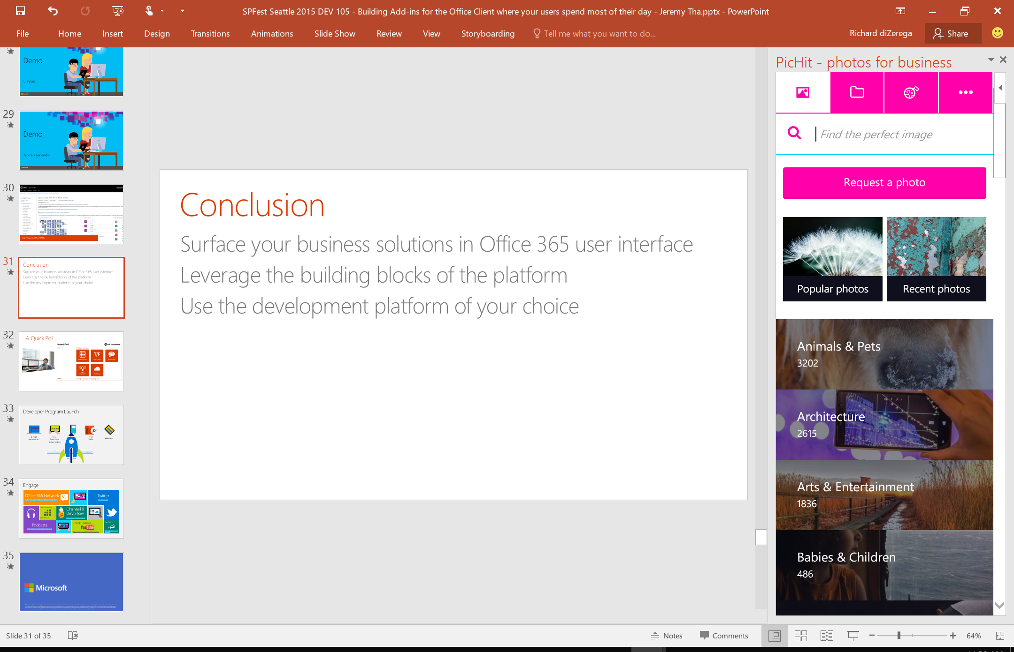
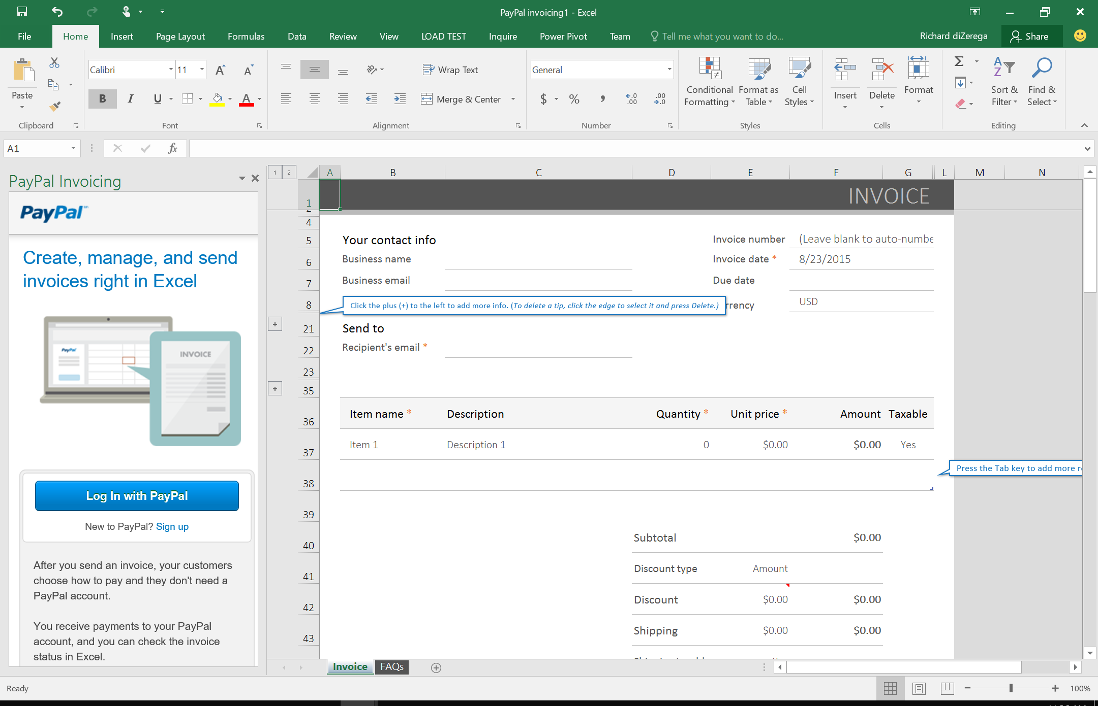
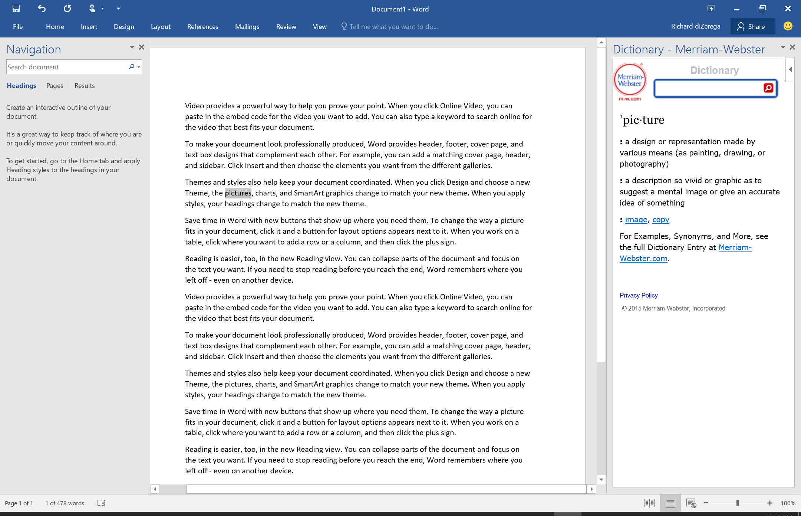
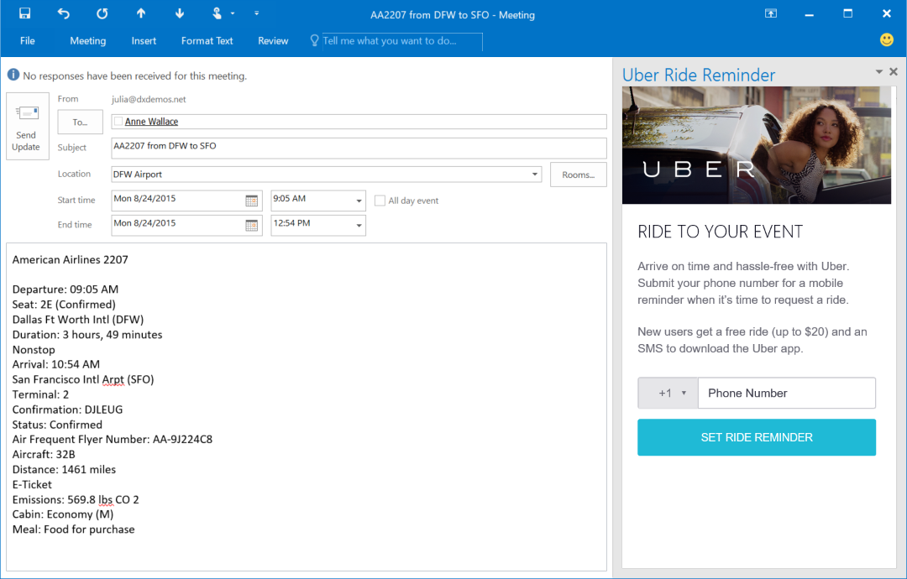
Task Pane Add-in

Slide 9
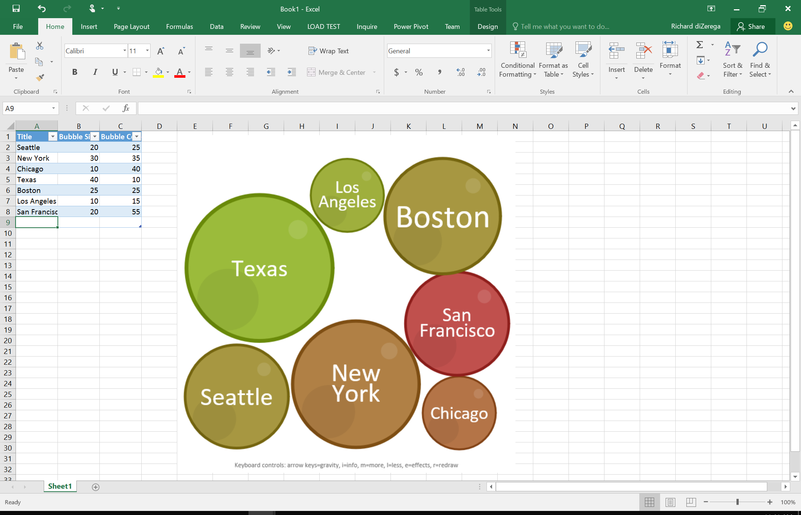
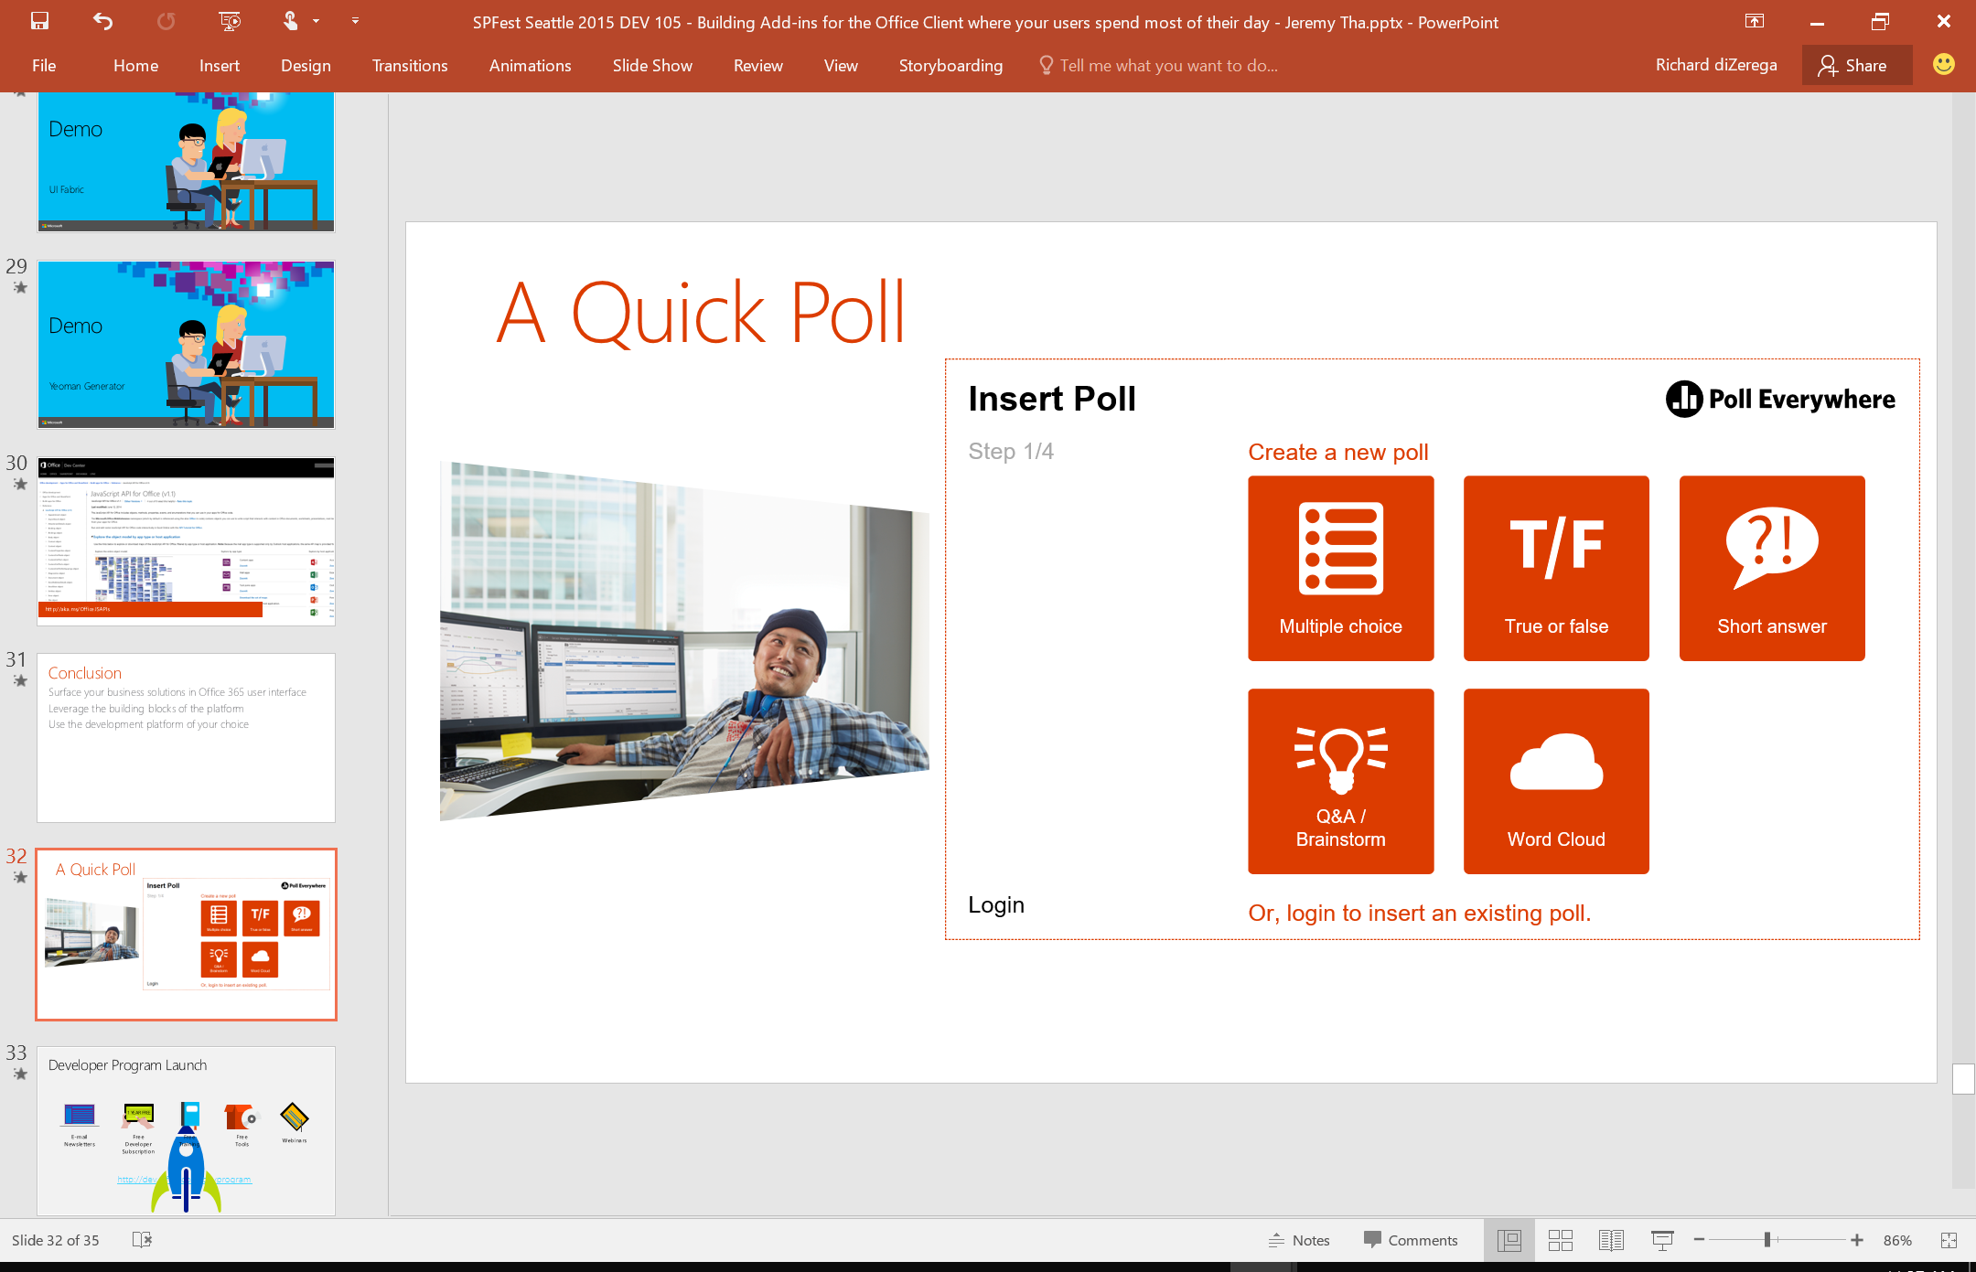
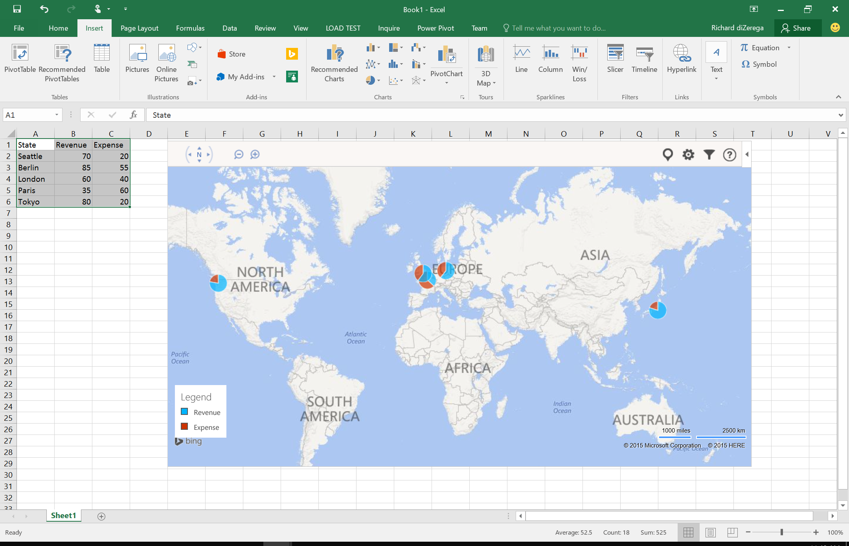
Content Add-in

Slide 10
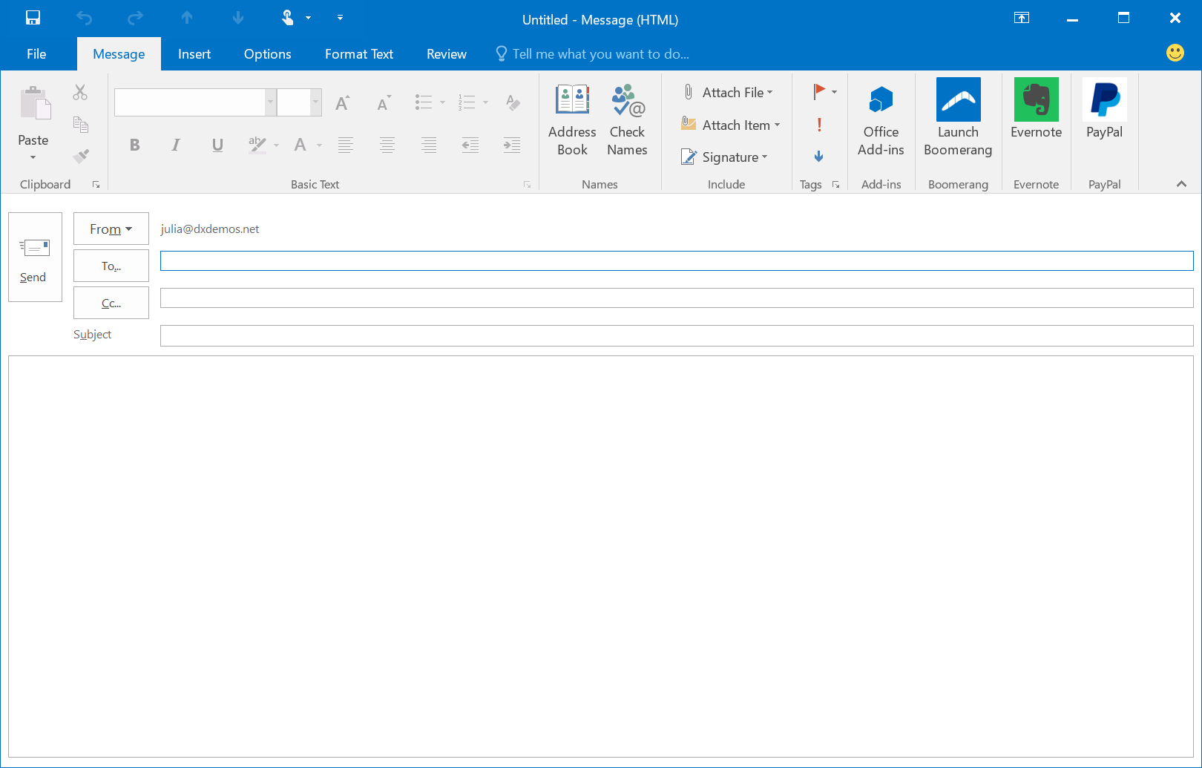
Add-in Command

Slide 11
Building Modern Office Add-ins
Napa (In-Browser Web Editor)
Microsoft Visual Studio
Web Editor of you choice + Manifest (Yeoman)

Slide 12
Workshop - Getting Started
http://aka.ms/dreamforce
Uses Napa (https://www.napacloudapp.com)
Step-by-step Instructions for 3 Exercises
Walk-through Videos for each Exercise and Bonus
Completed Solutions for each Exercise and Bonus
Requires Microsoft Account
Salesforce Developer Account (Exercise 3)

Slide 13
Questions?

